Slide 1

Predicting Michelin Stars: What Makes a Restaurant Stand Out?
Abby Kohan
Data 400

Slide 2





What is the Michelin Guide?
Created in 1900 by the Michelin tire company to encourage travel and driving.
Evolved into the world’s most prestigious restaurant rating system.
Michelin Stars:
= “Worth a stop”
= “Worth a detour”
= “Worth a special trip”
Bib Gourmand: Award for exceptional food at a more affordable price.
Receiving a Michelin award brings global recognition and can transform a restaurant’s success.
Notes:
"The Michelin Guide began over a century ago as a marketing tool by the Michelin tire company. Over time, it transformed into the most respected restaurant rating system in the world. Restaurants can earn one, two, or three Michelin stars, where one means it’s worth stopping, two means it’s worth making a detour, and three means it’s worth a special trip. In addition to stars, there’s also the Bib Gourmand distinction, which highlights high-quality food at a more accessible price point. For chefs and restaurant owners, earning one of these awards can completely change their reputation, visibility, and even their financial future."

Slide 3
Research Question
What factors best predict whether a restaurant will earn a Michelin star?
Focus Variables
Approach
Scraped Michelin Guide data (US)
Built dataset with restaurant name, city, cuisine, price, award type, latitude/longitude
Used exploratory data analysis and logistic regression to identify predictors
Cuisine type
Price level
City/Location

Slide 4

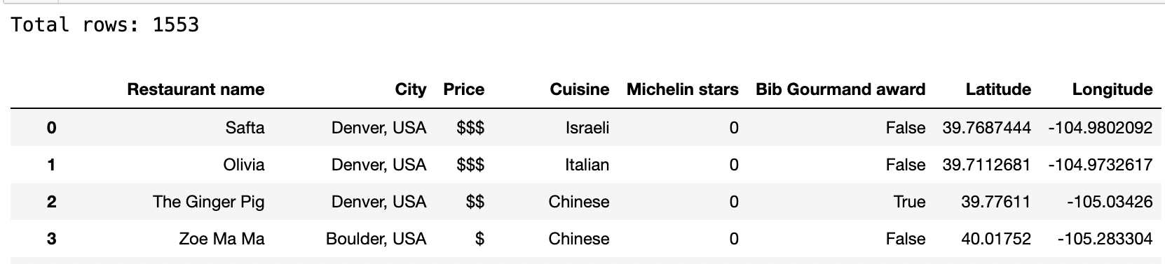
Dataset
Restaurants in USA only – 1553 results

Slide 5
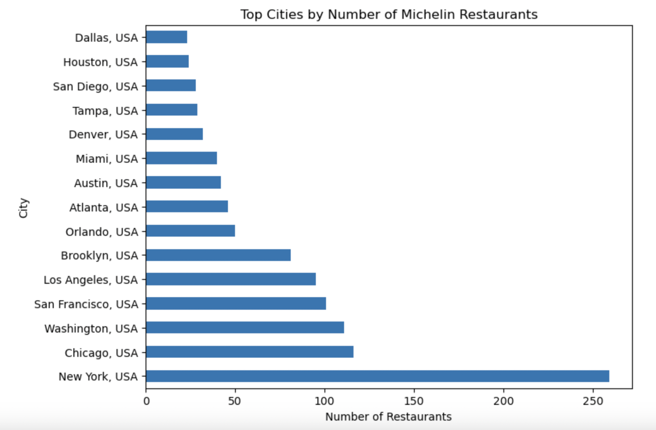
Exploratory Data Analysis
Michelin- listed restaurants are concentrated in a handful of cities
New York City has by far the largest share (~260+)
Chicago, Washington DC, and San Francisco follow, but at less than half NYC’s count
Most other cities have fewer than 50 listings
Includes starred, Bib Gourmand awarded, and recommended restaurants
Notes:
"This chart shows the number of Michelin restaurants by city. Michelin recognition in the US is very concentrated — New York City dominates with more than 250 listings, far outpacing any other city. Chicago, Washington DC, and San Francisco also have significant numbers, but less than half of New York’s total. Beyond those, we see places like Los Angeles, Brooklyn, and Miami, but most cities have fewer than 50 Michelin restaurants. This reinforces the idea that location is one of the strongest factors in Michelin recognition."

Slide 6
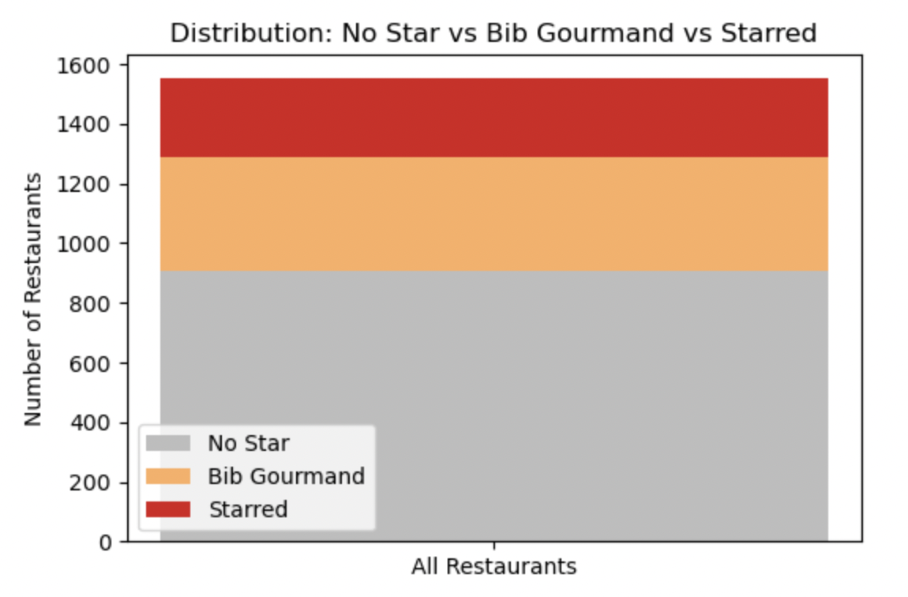
EDA: Continued
Most restaurants in the Guide hold no award
Bib Gourmand highlights affordable, high-quality spots
Only a small fraction earn Michelin stars
Underscores the exclusivity of Michelin recognition
Notes:
“As you can see here, the majority of Michelin Guide restaurants don’t have any award at all. A smaller group receive the Bib Gourmand for value dining, and only a small fraction achieve a Michelin star. This highlights just how selective the Michelin system is.”

Slide 7
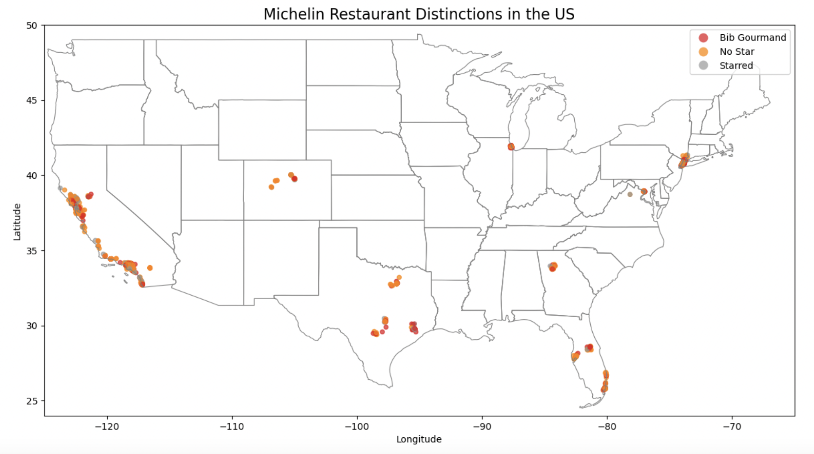
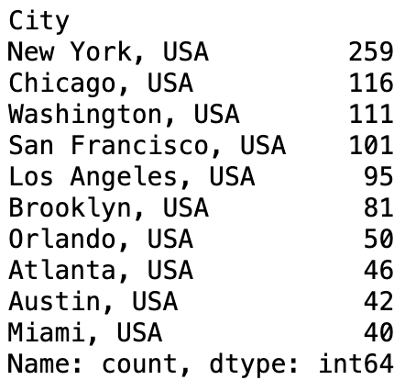
US Map
Michelin restaurants cluster in major cities
Heavy concentration on the East and West Coasts
Sparse coverage across much of the U.S. interior
Reflects Michelin’s urban and regional focus
Chicago stands out as an inland hub
Michelin recognition is concentrated in coastal cities, with large regions of the U.S. left unrepresented
Notes:
“When we plot the data, Michelin’s focus becomes clear. Restaurants are concentrated in big metropolitan areas, especially on the East and West Coasts. New York, San Francisco, and Los Angeles dominate, while Chicago stands out as the one inland city with a strong Michelin presence. Outside of these areas, much of the U.S. has no Michelin representation at all. So the Guide is selective not only in terms of quality, but also geography.”

Slide 8
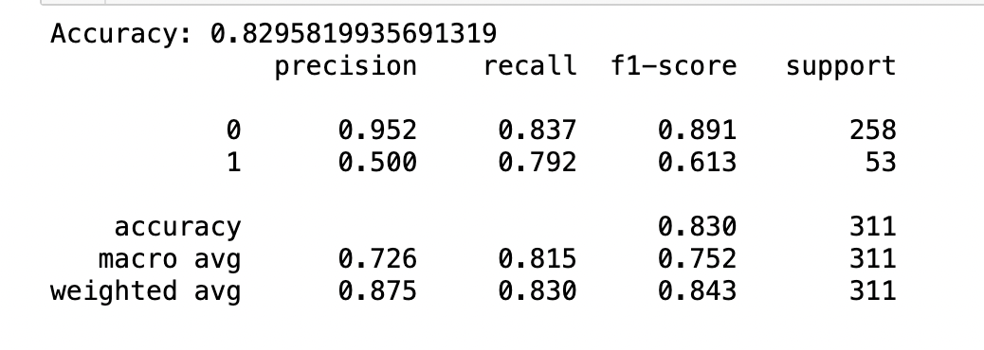
Logistic Regression Model
How well did the model perform?
Model accuracy ~83% overall
Strong at predicting non-starred restaurants
Less precise for starred restaurants, but recall shows it catches most
Price, cuisine, and city are strongest predictors
Model captures Michelin selectivity fairly well but struggles with the rare starred restaurants.
Goal: predict whether a restaurant has a star (yes/no)
Features used: Cuisine, Price, City
Outcome variable: Starred vs Not

Slide 9
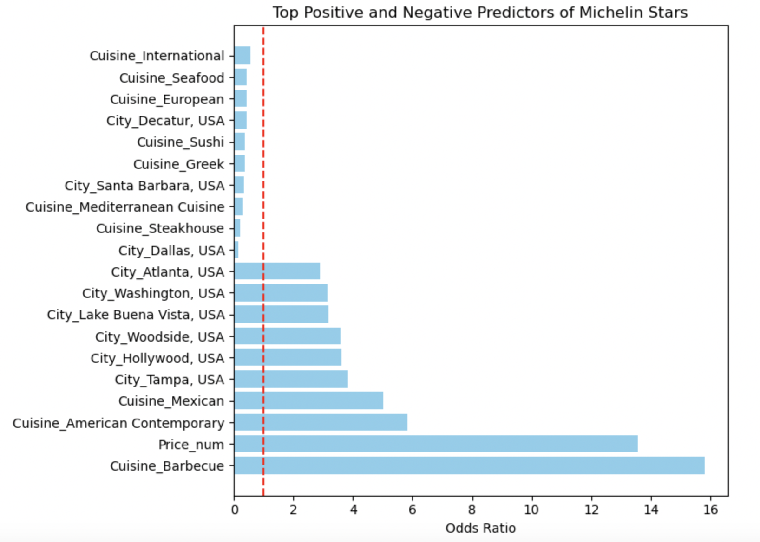
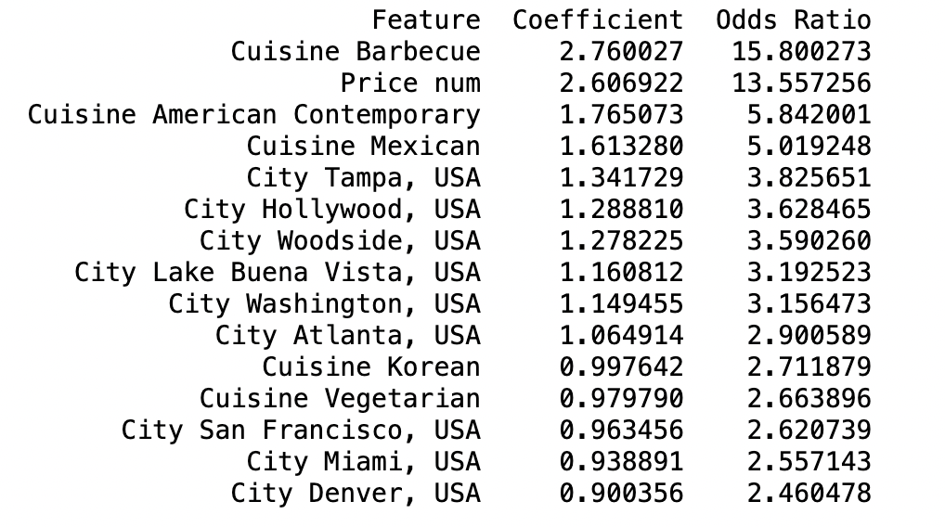
Odds Ratios (Top Predictors)
Price is the strongest predictor → higher prices greatly increase odds
Cuisine effects: e.g., Barbecue, American Contemporary, Mexican
City effects: some cities (e.g., Washington DC, Hollywood, Tampa) stand out
Limitation: small sample sizes can exaggerate certain predictors
Price, cuisine, and city are the biggest drivers of Michelin recognition
Notes:
“These are the odds ratios from my logistic regression model. An odds ratio above 1 means a predictor increases the chance of a restaurant earning a Michelin star. You can see that price is by far the strongest factor — each step up in price category multiplies the odds of getting a star by over 13. We also see cuisine effects, with barbecue, American Contemporary, and Mexican restaurants showing higher odds. Some cities also stand out, like Washington DC and Hollywood. But I want to note a caveat: barbecue looks like the top predictor, but that’s likely due to a small sample size in the dataset. So while price and location are very robust predictors, some cuisine results should be interpreted with caution.

Slide 10

Limitations
What the results suggest: Michelin favors certain cuisines, high prices, big cities
Data imbalance: most restaurants have no stars → harder to predict starred ones
Small sample sizes: inflates results for some cuisines or cities
Geographic bias: Michelin Guide only covers certain U.S. cities/regions
Unmeasured factors: service, chef reputation, ambiance not captured in data
Notes:
“There are a few caveats to keep in mind. First, the dataset is heavily imbalanced — most restaurants don’t have stars — so while the model predicts non-starred restaurants very well, it struggles more with the rare starred ones. Second, small sample sizes can make some predictors, like Barbecue cuisine, look stronger than they really are. Third, the Michelin Guide itself is geographically biased: it only reviews restaurants in certain cities, so much of the country isn’t represented. And finally, my model doesn’t capture qualitative factors like chef reputation, service, or atmosphere, which Michelin also considers.”

Slide 11
Conclusion
Research question:
Can cuisine, price, and location predict Michelin stars? → Yes
Findings:
Price is the strongest predictor; cuisine & city matter too
Future work:
Test multinomial model (0 vs Bib vs 1–3 stars), add predictors (chef, ambiance, reviews)
Bias:
Michelin recognition is concentrated in expensive, coastal/urban restaurants
Notes:
“So to wrap up, my question was whether cuisine, price, and location can predict Michelin stars — and the results show that they can. Price came out as the strongest predictor, but certain cuisines and cities also had an effect. At the same time, Michelin recognition isn’t evenly distributed — it’s concentrated in expensive restaurants in major coastal cities and Chicago, which reflects cultural and economic biases in the guide.
If I had more time, I’d extend the model to multinomial classification — separating Bib Gourmand, one, two, and three stars — and bring in additional features like chef reputation, ambiance, or online reviews. That could give an even richer picture of what drives Michelin’s decisions.”

